Slide 1
A Comparison of Techniques Applied to Digit Recognition
Deric Pang (dericp), Saidutt Nimmagadda (nimmas)

Slide 2
Goal
Our project intended to implement and compare three different techniques – nearest neighbor regression, support vector machines, and convolutional neural networks – and their performance in classifying pixel data vectors into the digits that they represent.

Slide 3
Dataset: MNIST pixel data
Training Set
60000 rows of pixel data that is already normalized
Each row has 1 label and 783 pixel features
Final model built either from this set in its entirety, or from a subset of it depending on algorithm
Cross-Validation
A 2000 row block from the training set was segmented into validation blocks and iterated over to tune hyperparameters
Test Set
10000 rows of pixel data that is already normalized
Each row has 1 label and 783 pixel features

Slide 4
Baseline Implementations (for comparison)
SciKit K-Nearest Neighbors
SciKit Support Vector Machines
Radial Basis Function Kernel
Linear Kernel
TensorFlow Convolutional Neural Network

Slide 5
Methods We Implemented
Nearest Neighbors Regression using two classification methods
Classification based on the classification with the lowest average distance from the query point amongst the k nearest neighbors
Classification based on the Nadaraya Watson Gaussian Kernel Weighted Average
Support Vector Machine
PEGASOS

Slide 6
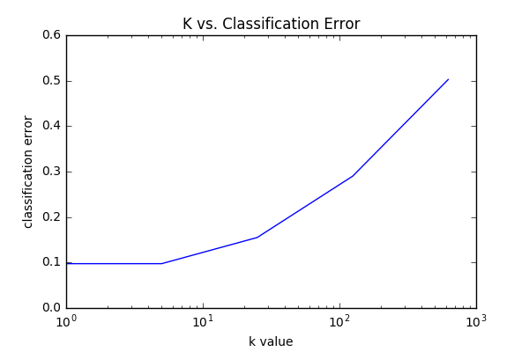
SciKit K-Nearest Neighbors
Conclusion: On the Baseline K-Nearest Neighbors algorithm, classification error was minimized when the point most similar to the query point was found and its classification was the query point’s classification (k = 1). We will use k = 1 when calculating our test error. When calculating our test error, we will use the entire training data set as the “model” for our test set.
Classification error calculated via cross validation, and found that a k of 1 was optimal. Cross validation was done over a training block of 2000 rows.

Slide 7
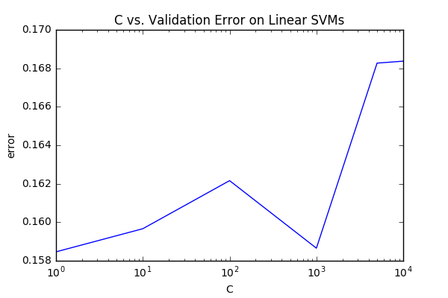
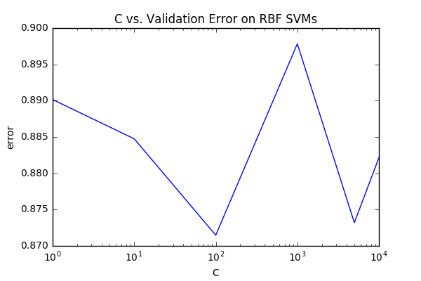
SciKit SVM
We found that the Linear SVM had a markedly lower validation error than the RBF SVM. We were surprised by this. The best C value, according to our cross-validation, was C = 1, but we're skeptical that variations in validation error are due to C value rather than variations in validation blocks because the differences in error are so small. Regardless, we'll build a Linear SVM model with C = 1 and an RBF SVM model with C = 100 with 20000 rows of our training set (for runtime purposes) and calculate test error.

Slide 8
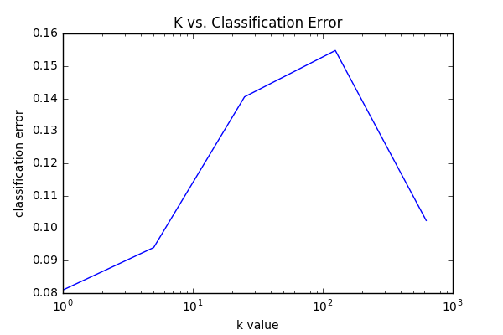
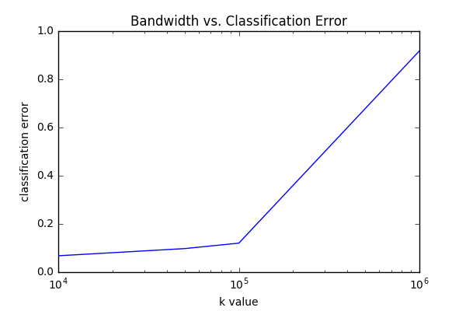
K-Nearest Neighbors (Our Implementation)
Like the baseline we found, through cross validation, that a k of 1 to be best for our k-NN regression. For kernel regression, we found a bandwidth of 10^4 was best for our Nadaraya-Watson Gaussian kernel regression. Let's find out our test error with a model that is 1/4 of the training set for both algorithms.

Slide 9
Test Error

Slide 10
Notes
Because of runtime constraints, we limited the model size of:
Our K-NN implementation
Gaussian kernel was especially difficult to deal with in terms of runtime
Baseline SVM runtime is intractable
Convergence condition seemed difficult to meet, hence training on the entire dataset was infeasible
As a result:
Our K-NN had a higher error than the library implementation
SciKit SVMs had higher error than our implementations
Surprising:
SVM with a radial basis function kernel did significantly worse than linear SVM

Slide 11
For Deric:
Library K-NN: 0.0309
Our KNN: 0.045
Library SVM RBF: 0.8865
Library SVM Linear: 0.1471

